Slide 1


ECE 625 Course Project: Modelling 2015 Edmonton’s Property values
Present by:
Group 7

Slide 2



Outline
01
Data Cleaning
02
Objective 1
Results & Conclusion
03
Objective 2
Conclusion
Results & Conclusion

Slide 3
Data Preprocessing
1

Slide 4
Data Cleaning -Step 1: understand the data given
Data Description:
Edmonton Real Estate Data from 2015
71,525 Properties in total
36 descriptive features
Organized dataset but difficult to use directly in our model

Slide 5
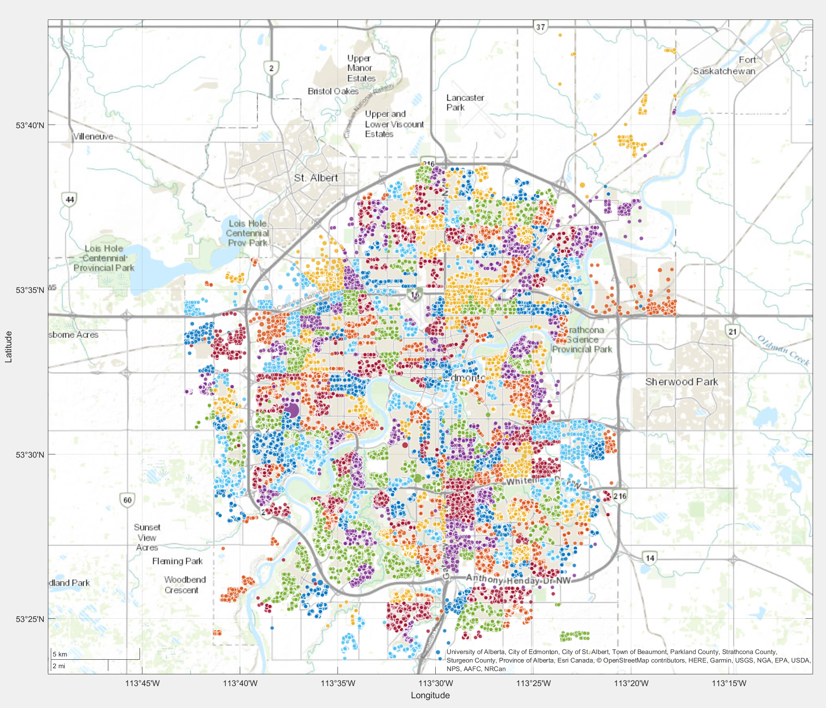
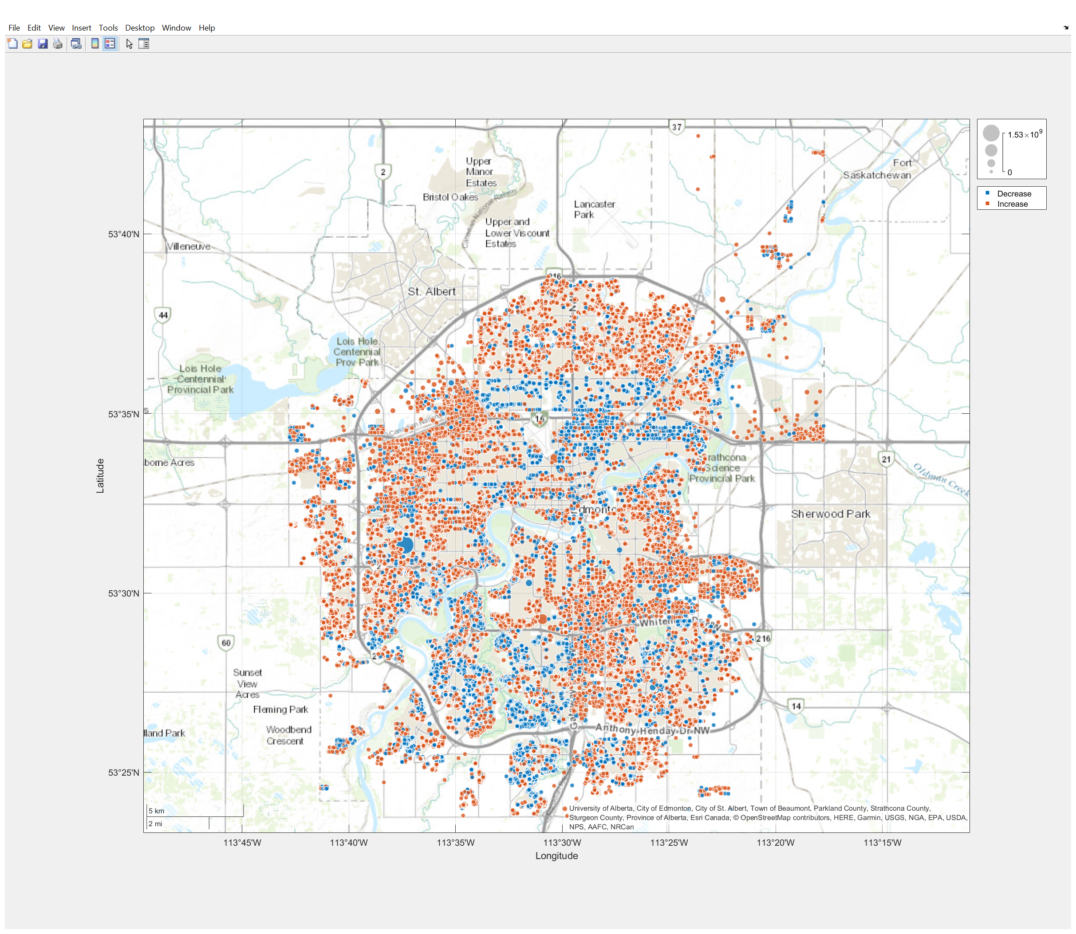
Data Cleaning -Step 1: understand the data given

Slide 6
Data Cleaning -Step 2: Format & Modify Features
Features omitted:
Not useful in modeling property value
Taxroll_number: useful when retrieving 2016 assessed property values.
Building_name
Location (house_number, house_suff, street_name, postal_code, city, full_address, lon, lat)
Geometry
Result_code
Result_message
Empty Column
House_suit
Result_description

Slide 7
Data Cleaning -Step 2: Format & Modify Features
Features omitted:
Model complexity trade-off
Landuse_description:
Detailed property type
500 different categories.
Market_building_class:
205 different classes.
Repetition
Build_year_mbc: same as “effective_build_year”
“Display_type”
Categorical variable with 3 classes: “RES”, “NONRES”, “LAND”
Different model built for different class

Slide 8
Data Cleaning -Step 2: Format & Modify Features
property_type | CODE
RESIDENTIAL | 1
MULTI-RES | 2
URBAN | 3
COMMERCIAL | 4
INDUSTRIAL | 5
AGRICULTURE | 6
valuation_group | CODE
HOTEL MOTEL | 1
IND CONDO | 2
INDUSTRIAL | 3
MULTI | 4
OFFICE | 5
RES CONDO | 6
RESIDENTIAL | 7
RESIDENTIAL LAND | 8
RESIDENTIAL NORTH | 9
RESIDENTIAL RIVVAL | 10
RESIDENTIAL SOUTH | 11
RESIDENTIAL WC | 12
RETAIL | 13
RETAIL CONDO | 14
RETAIL PLAZA | 15
SHOPPING CENTRE | 16
SPECIAL PURPOSE | 17
Multi-class Categorical Feature used:
Property_type
Similar with “landuse_description”
More general and inclusive
Valuation_group
Neighbourhood (389 classes)
Market position
Location

Slide 9
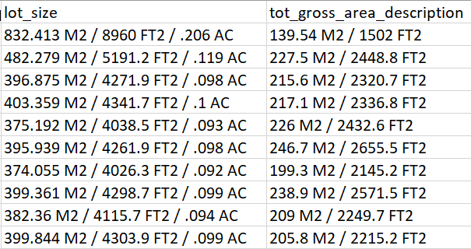
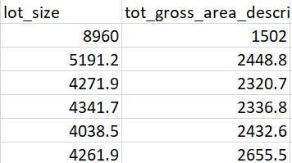
Data Cleaning -Step 2: Format & Modify Features
Features modified:
“Lot_size” & “tot_gross_area_description”
Remove text data (unit)
Use “ft2” for consistency
“effective_build_year” to “Property age”

Slide 10
Data Cleaning -Step 3: Data grouping/Separation
“NON-LAND”
16 features used in objective 2
16/17 features used for objective 1
62315 observations used
“LAND”
10 features used in objective 1
10/11 features used in objective 2
4792 observations
Features used in Land dataset:
{'property_type'} {'neighbourhood'} {'basement_finished'} {'has_garage'}
{'has_fireplace'} {'building_count’}
{'walkout_basement'} {'air_conditioning'}
{'lot_size'} {'Assessed_value_2015'}
Features absent in Land dataset:
“Valuation_goup”
“Property age”
“fully_complete”
“net_area”
“site_coverage”
“tot_gross_area_description”

Slide 11
Objective 1 : Predicting 2015 Property values
2

Slide 12
Objective 1: Models
Fit a total of three separate models for assessing the 2015 house value
We fit a global multiple linear regression
Fit two additional optimized models using regularization via ridge regression and the lasso

Slide 13
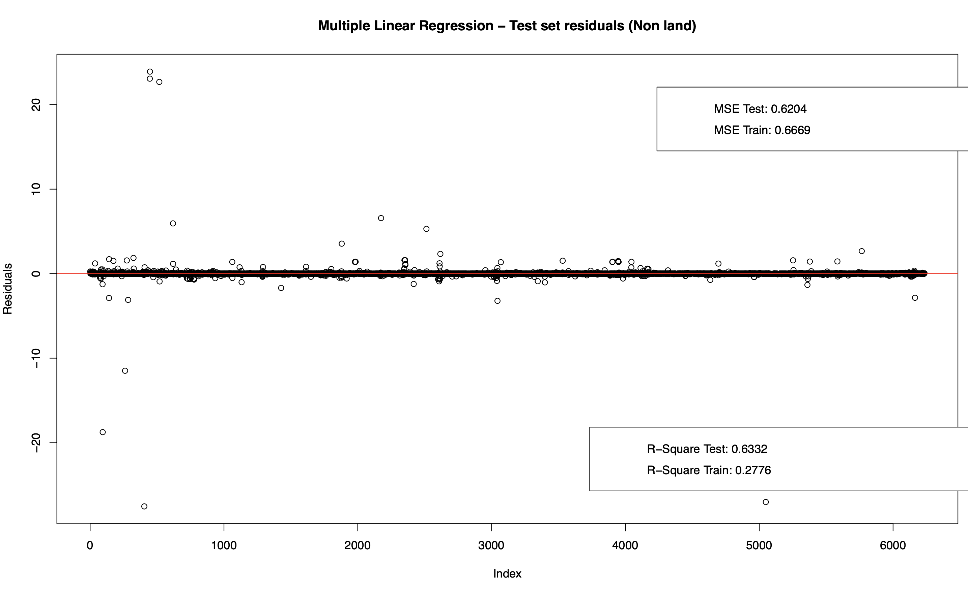
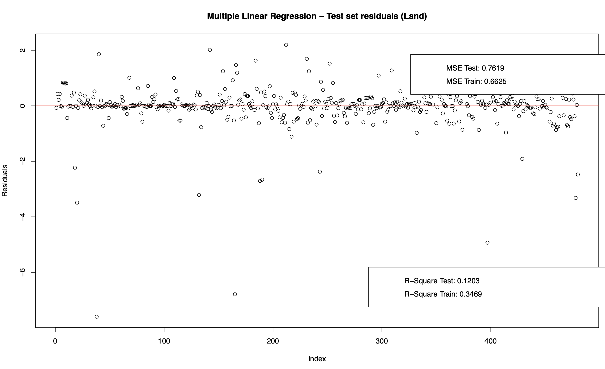
Multiple Linear Regression

Slide 14
Multiple Linear Regression: Results
“Nonland dataset”

Slide 15
Multiple Linear Regression: Results
“Land dataset”

Slide 16
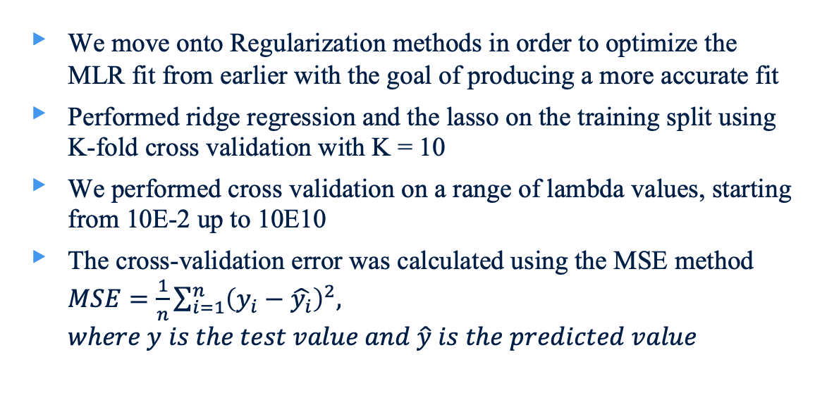
Ridge Regression & The Lasso
We move onto Regularization methods in order to optimize the MLR fit from earlier with the goal of producing a more accurate fit
Performed ridge regression and the lasso on the training split using K-fold cross validation with K = 10
We performed cross validation on a range of lambda values, starting from 10E-2 up to 10E10
The cross-validation error was calculated using the MSE method $MSE=\frac{1}{n}\sum_{i=1}^{n}{{\left(y_{i}−\hat{y_{i}}\right)}^{2},}$ $where y is the test value and \hat{y} is the predicted value$

Slide 17
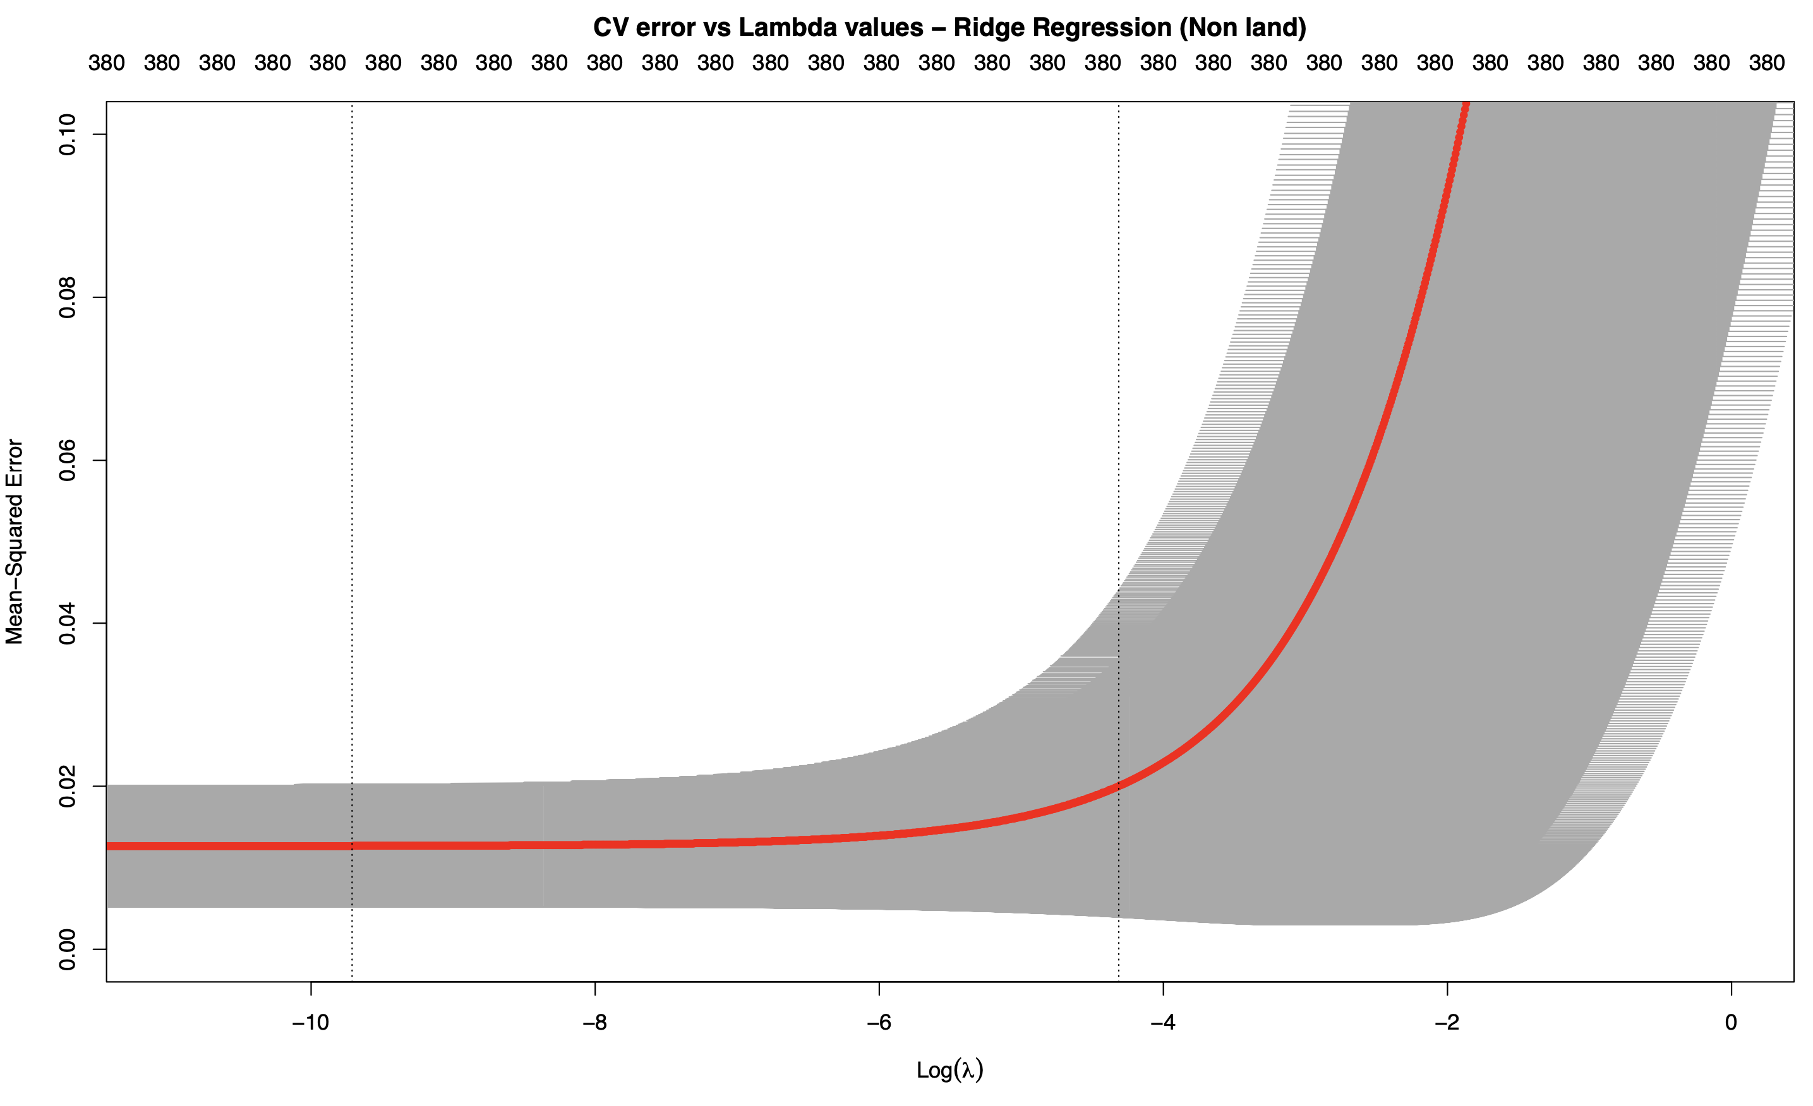
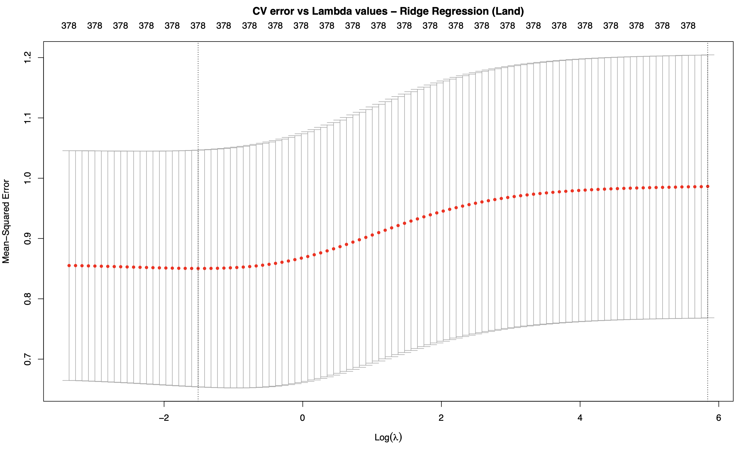
Ridge Regression – Cross Validation

Slide 18
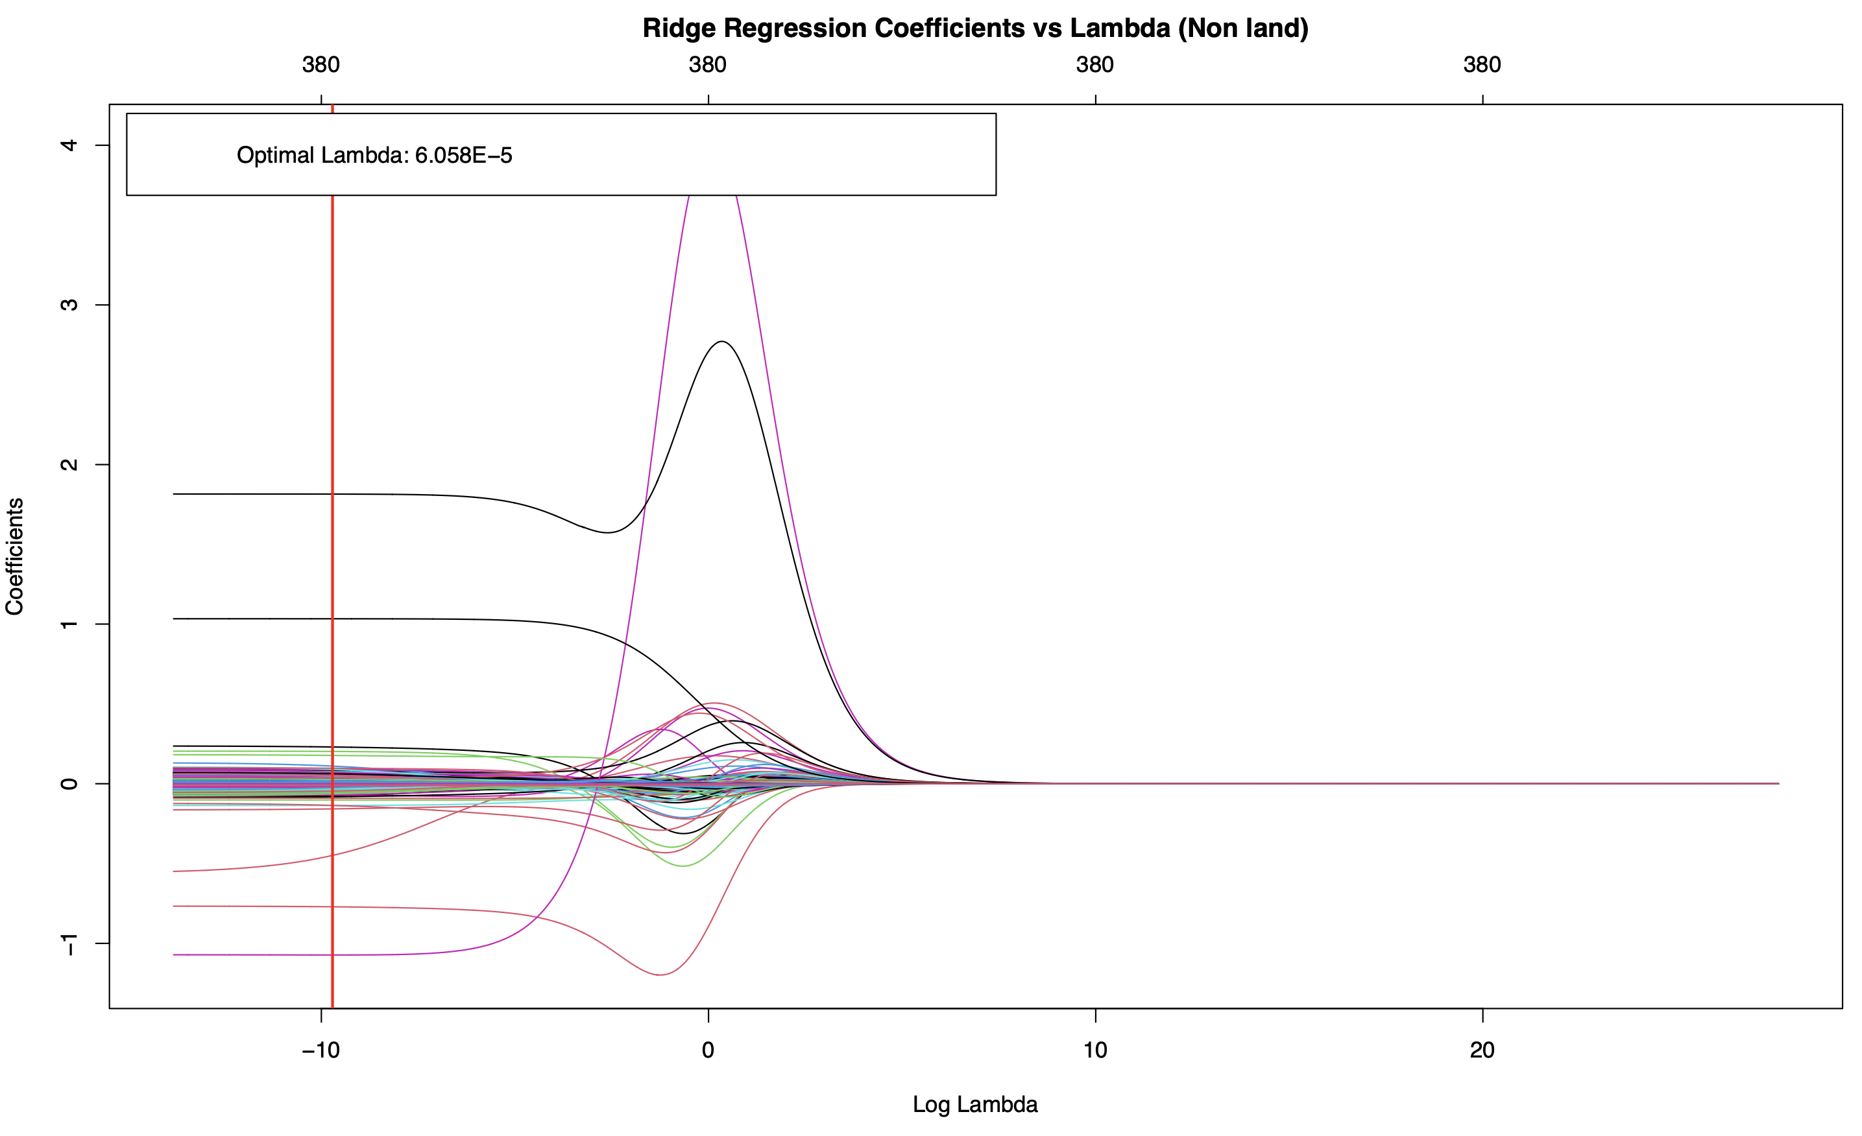
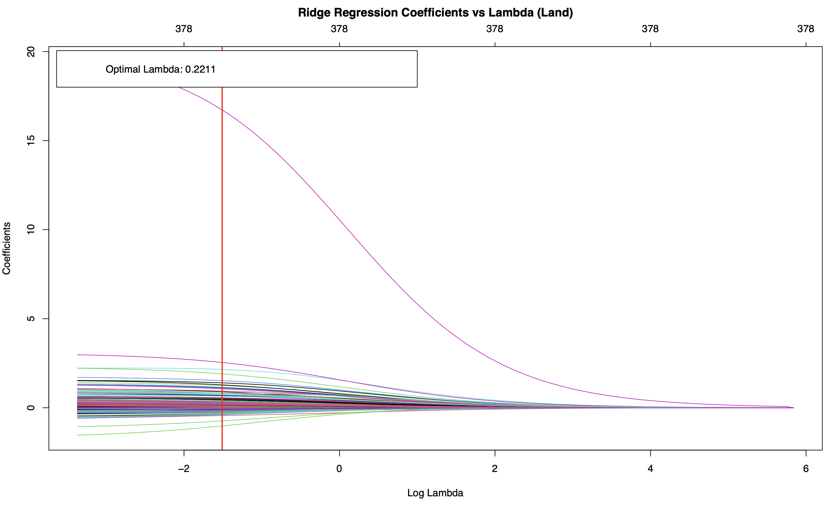
Ridge Regression - Coefficient Plots
Via 10-fold cross-validation, the optimal lambda value for the “nonland” data set was 6.058E-5 and for the “land” data set was 0.2211

Slide 19
Ridge Regression: Results (Nonland)

Slide 20
Ridge Regression – Results (Land)

Slide 21
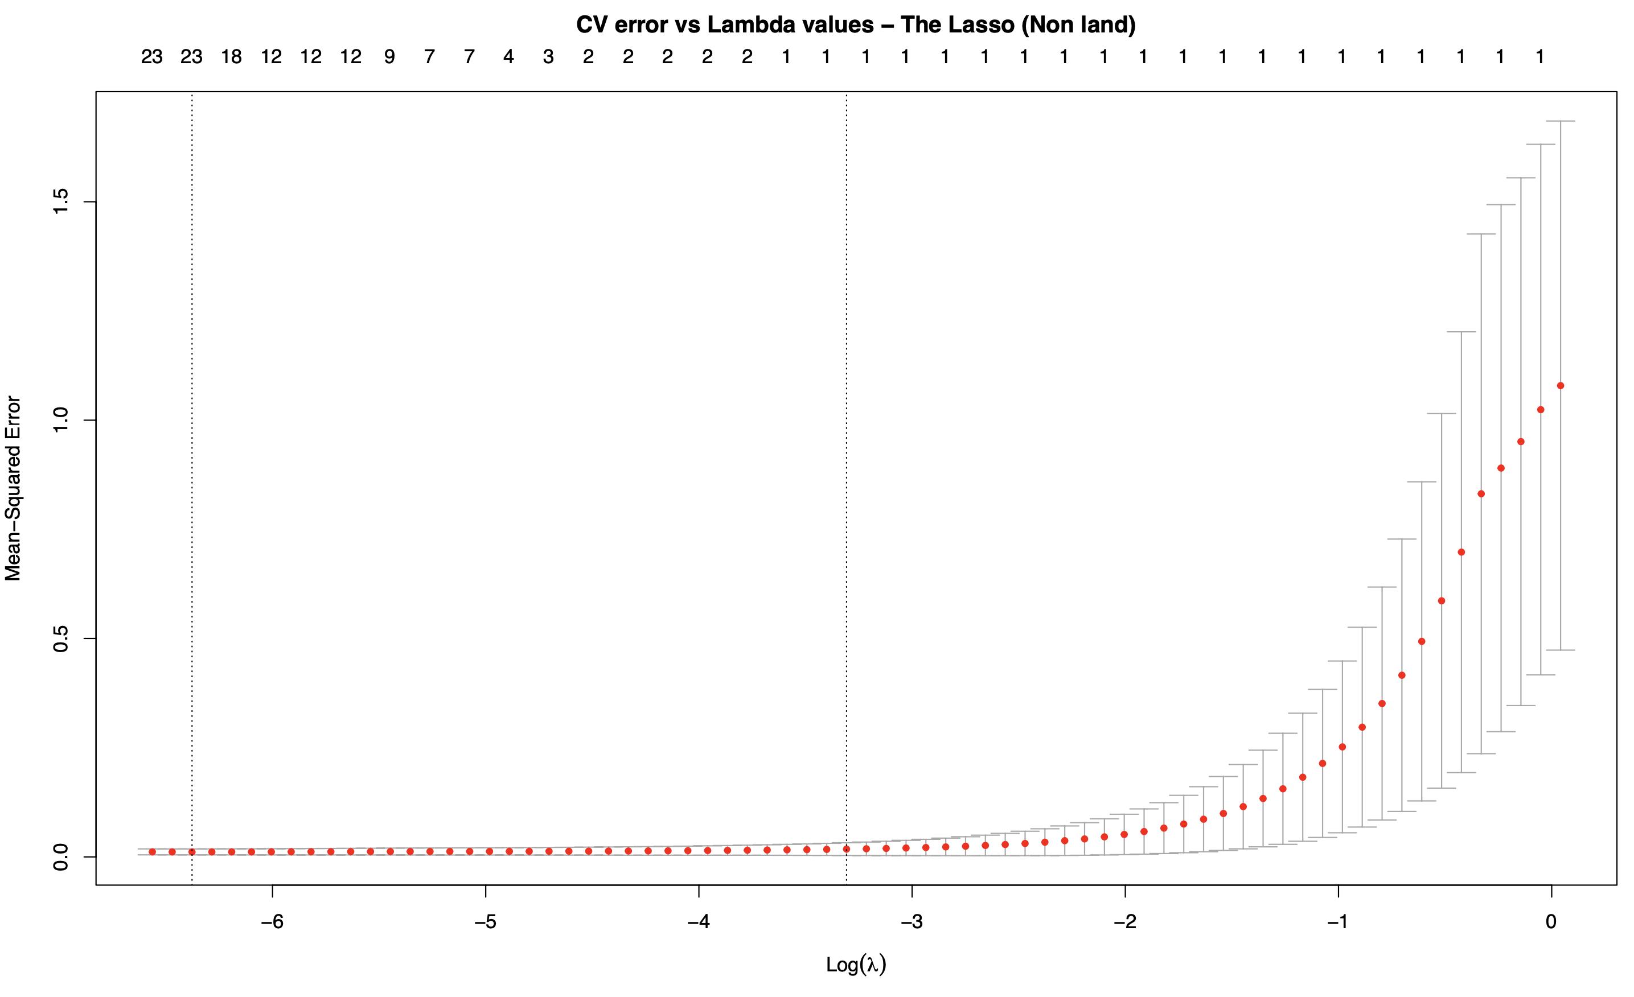
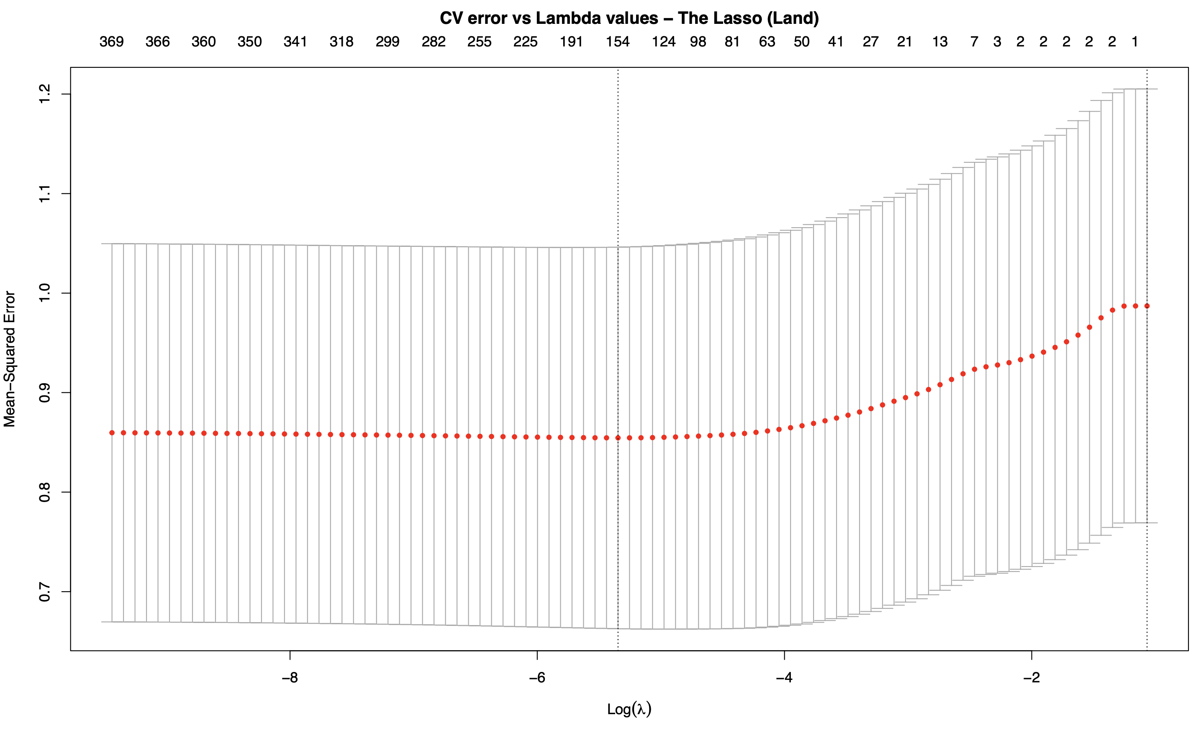
The Lasso – Cross Validation

Slide 22
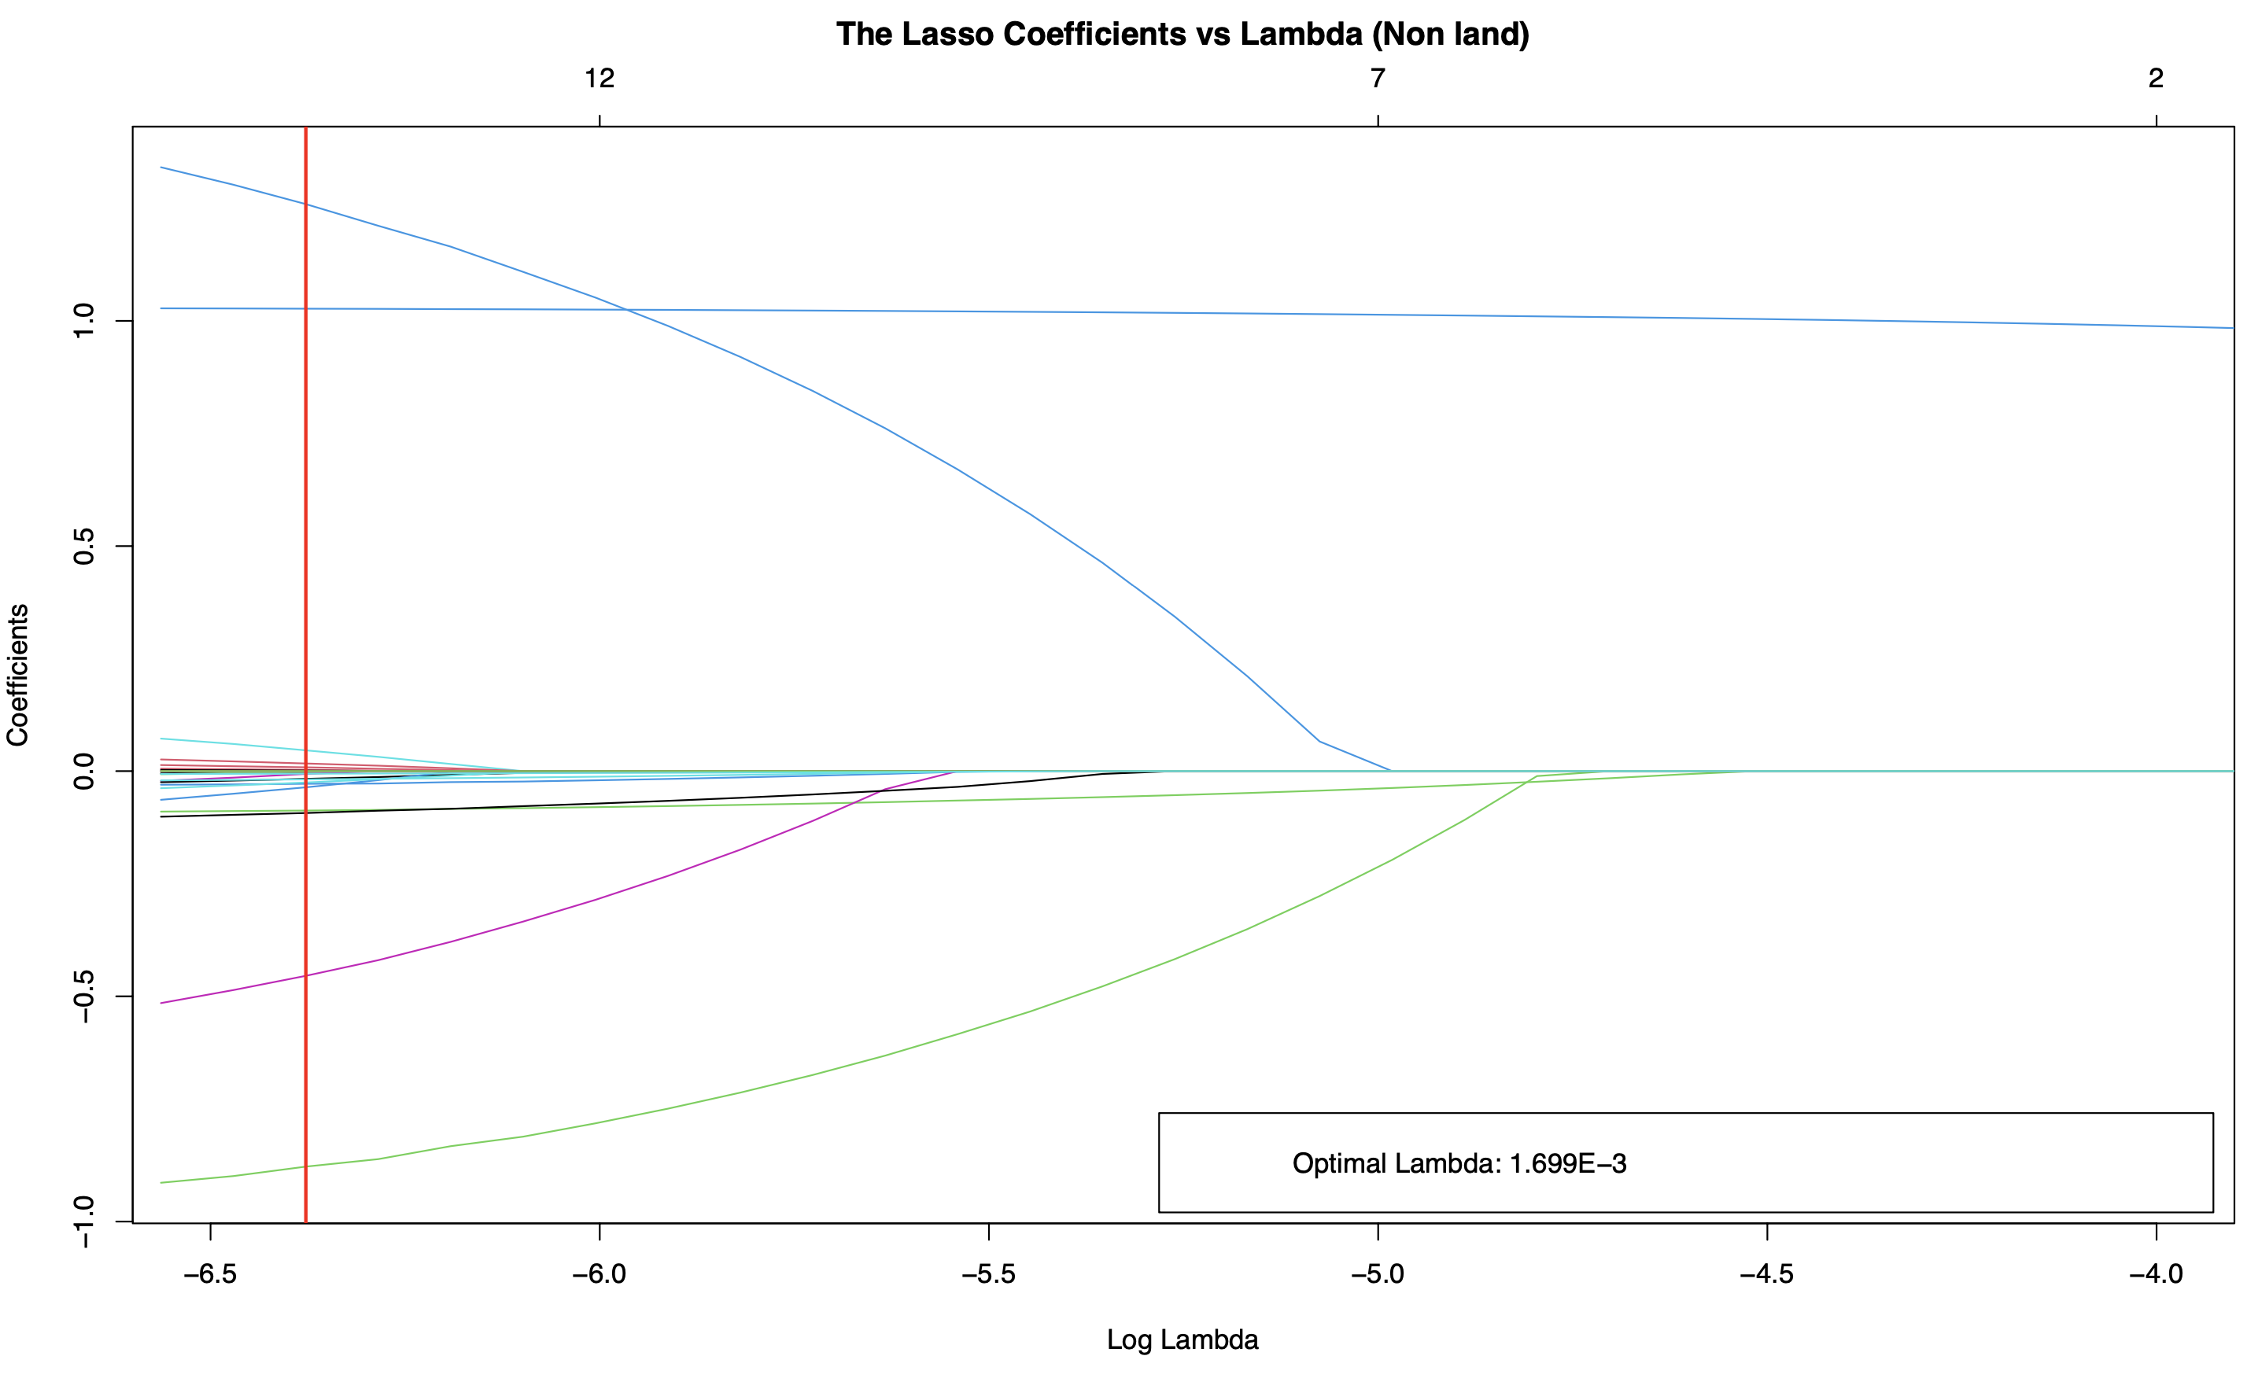
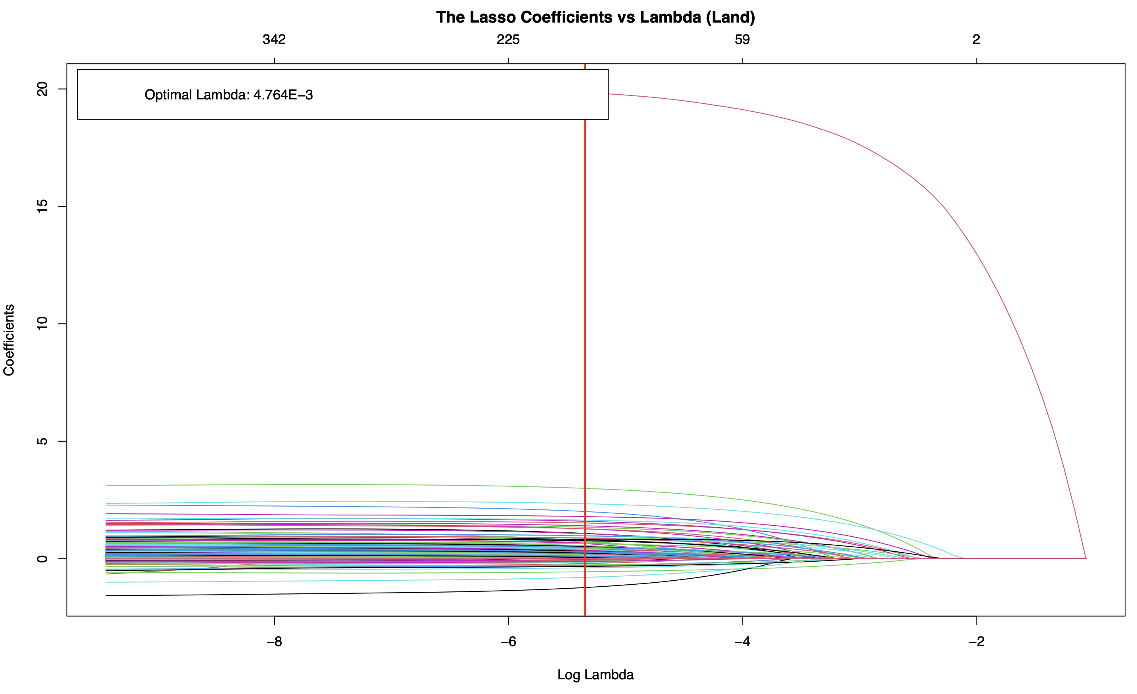
The Lasso – Coefficient Plots
Via 10-fold cross-validation, the optimal lambda value for the “nonland” data set was 1.699E- 3 and for the “land” data set was 4.764E-3.

Slide 23
The Lasso – Results (Nonland)

Slide 24
The Lasso – Results (Land)

Slide 25
Objective 1: Conclusions

Slide 26
Objective 2 : Predicting Property value change
3

Slide 27
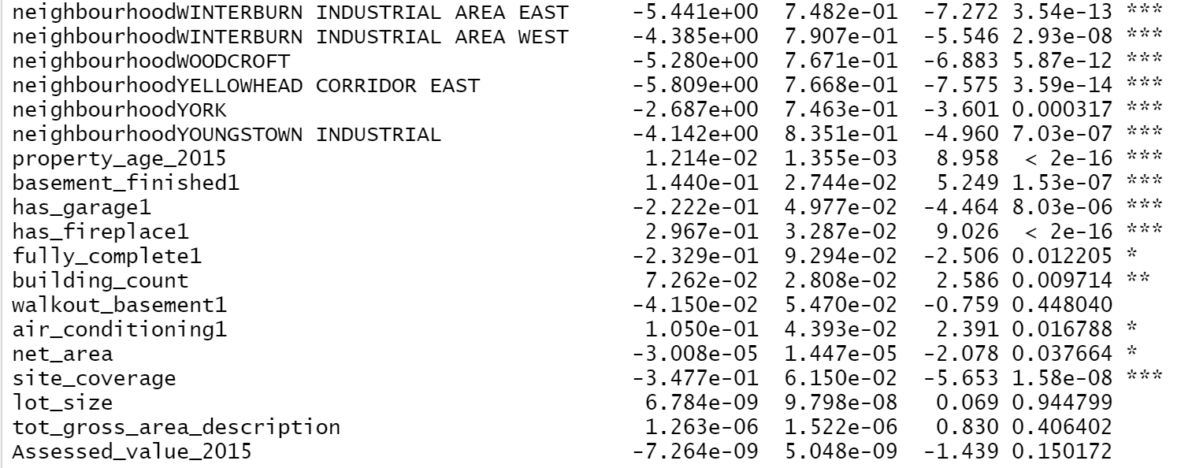
Objective 2: Models – Logistic Regression
First model on “non-land” dataset:
Not significant in this model

Slide 28
Objective 2: Results – Logistic Regression
First model on “non-land” dataset:
Almost identical: 2015 assessed value not significant for non-land dataset

Slide 29
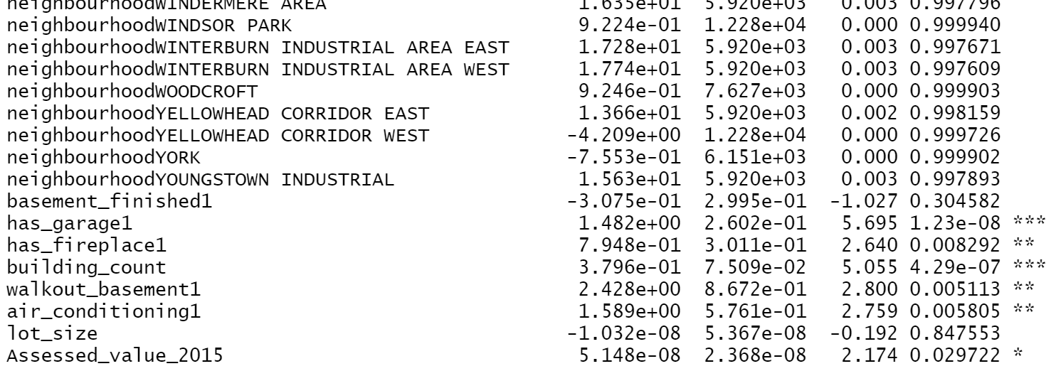
Objective 2: Models – Logistic Regression
First model on “land” dataset:
Not significant in this model

Slide 30
Objective 2: Results – Logistic Regression
First model on “land” dataset:

Slide 31
Objective 2: Models – LDA
Second model on “non-land” dataset:
> lda.fit = lda(change~.-lon-lat-Assessed_value_2016,data=nonland,subset = train)
> lda.fit2 = lda(change~.-lon-lat-Assessed_value_2016- Assessed_value_2015, data=nonland,subset = train)
> summary(lda.fit)
Length Class Mode
prior 2 -none- numeric
counts 2 -none- numeric
means 756 -none- numeric
scaling 378 -none- numeric
lev 2 -none- character
svd 1 -none- numeric
N 1 -none- numeric
call 4 -none- call
terms 3 terms call
xlevels 9 -none- list
> summary(lda.fit2)
Length Class Mode
prior 2 -none- numeric
counts 2 -none- numeric
means 754 -none- numeric
scaling 377 -none- numeric
lev 2 -none- character
svd 1 -none- numeric
N 1 -none- numeric
call 4 -none- call
terms 3 terms call
xlevels 9 -none- list

Slide 32
Objective 2: Results – LDA
Second model on “non-land” dataset:

Slide 33
Objective 2: Models – LDA
Second model on “land” dataset:
> landlda.fit = lda(change~.-lon-lat-Assessed_value_2016,data=land,subset = land.train)
> landlda.fit2 = lda(change~.-lon-lat-Assessed_value_2016-Assessed_value_2015, data=land,subset = land.train)
> summary(landlda.fit)
Length Class Mode
prior 2 -none- numeric
counts 2 -none- numeric
means 762 -none- numeric
scaling 381 -none- numeric
lev 2 -none- character
svd 1 -none- numeric
N 1 -none- numeric
call 4 -none- call
terms 3 terms call
xlevels 7 -none- list
> summary(landlda.fit2)
Length Class Mode
prior 2 -none- numeric
counts 2 -none- numeric
means 760 -none- numeric
scaling 380 -none- numeric
lev 2 -none- character
svd 1 -none- numeric
N 1 -none- numeric
call 4 -none- call
terms 3 terms call
xlevels 7 -none- list

Slide 34
Objective 2: Results – LDA
Second model on “land” dataset:

Slide 35
Objective 2: Models – QDA
Third model on “non-land” dataset:
> qda.fit = qda(change~.-lon-lat-neighbourhood-Assessed_value_2016, data=nonland, subset = train)
> qda.fit2 = qda(change~.-lon-lat-neighbourhood-Assessed_value_2016-Assessed_value_2015,data=nonland,subset = train)
> summary(qda.fit)
Length Class Mode
prior 2 -none- numeric
counts 2 -none- numeric
means 66 -none- numeric
scaling 2178 -none- numeric
ldet 2 -none- numeric
lev 2 -none- character
N 1 -none- numeric
call 4 -none- call
terms 3 terms call
xlevels 9 -none- list
> summary(qda.fit2)
Length Class Mode
prior 2 -none- numeric
counts 2 -none- numeric
means 64 -none- numeric
scaling 2048 -none- numeric
ldet 2 -none- numeric
lev 2 -none- character
N 1 -none- numeric
call 4 -none- call
terms 3 terms call
xlevels 9 -none- list
Actually QDA cannot have too much predictors. If we take “neighbourhood” into consideration, it will cause error “rank deficiency in group Decrease”

Slide 36
Objective 2: Results – QDA
Third model on “non-land” dataset:

Slide 37
Objective 2: Models – QDA
Third model on “land” dataset:
> landqda.fit = qda(change~.-lon-lat-neighbourhood-Assessed_value_2016, data=land, subset = train)
> landqda.fit2 = qda(change~.-lon-lat-neighbourhood-Assessed_value_2016-Assessed_value_2015,data=land,subset = train)
> summary(landqda.fit)
Length Class Mode
prior 2 -none- numeric
counts 2 -none- numeric
means 26 -none- numeric
scaling 338 -none- numeric
ldet 2 -none- numeric
lev 2 -none- character
N 1 -none- numeric
call 4 -none- call
terms 3 terms call
xlevels 7 -none- list
na.action 51758 omit numeric
> summary(landqda.fit2)
Length Class Mode
prior 2 -none- numeric
counts 2 -none- numeric
means 24 -none- numeric
scaling 288 -none- numeric
ldet 2 -none- numeric
lev 2 -none- character
N 1 -none- numeric
call 4 -none- call
terms 3 terms call
xlevels 7 -none- list
na.action 51758 omit numeric
Actually QDA cannot have too much predictors. If we take “neighbourhood” into consideration, it will cause error “rank deficiency in group Decrease”

Slide 38
Objective 2: Results – QDA
Third model on “land” dataset:

Slide 39
Objective 2: Support Vector Machines
We fit the support vector classifier (linear kernel SVM), the radial kernel SVM, and the polynomial kernel SVM and compared the corresponding test error rates
We fit the SVM models on “land” dataset, using 10-fold cross validation to determine the optimal cost values. Due to the high computational power required with the SVM, fitting the “nonland” dataset was not a feasible goal in our classification modeling
The optimal cost values for the linear, radial, and polynomial kernels were 5000, 4.414e+6, and 3e+12 respectively
This entire process was applied with the 2015 assessed value being a feature and with it not being a feature

Slide 40
Objective 2: Results – SVM (Land)

Slide 41
Objective 2: Conclusion – Comparing All models

Slide 42
Objective 2: Conclusion – Comparing All models

Slide 43
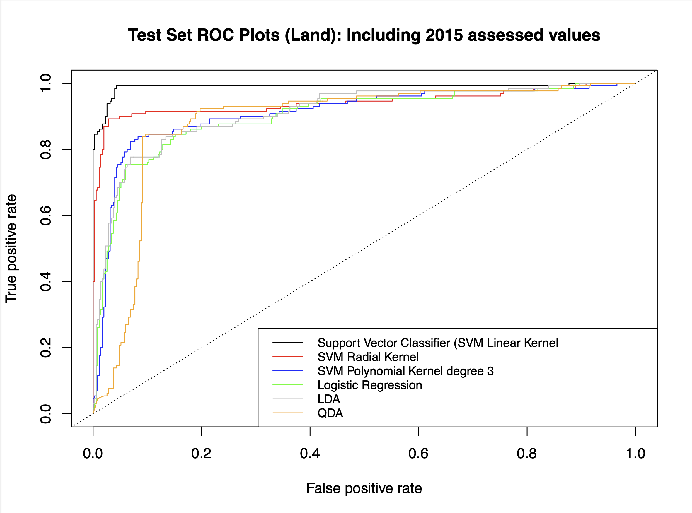
Objective 2: Conclusion – Comparing All models
From the ROC plots we can see that the linear kernel SVM has the best fit and has the lowest test error rate.

Slide 44
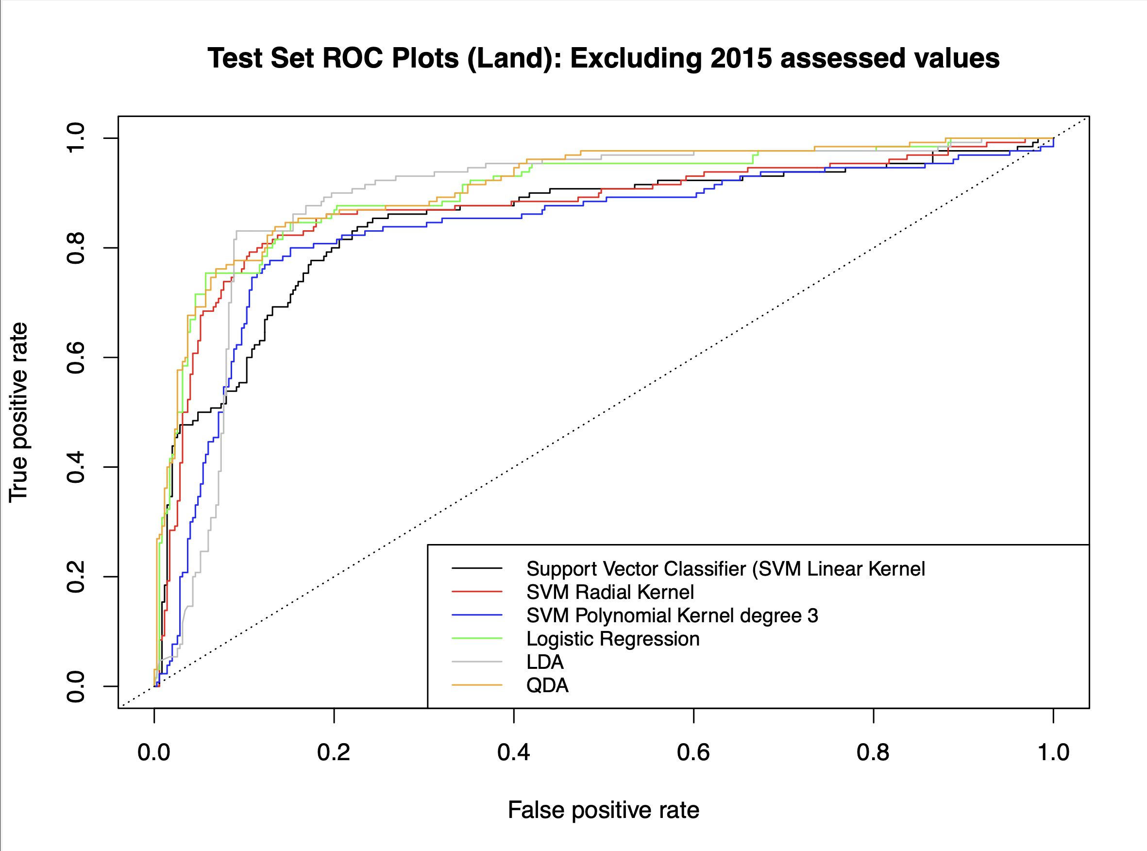
Objective 2: Conclusion – Comparing All models
We can see that the ROC plots and the test error rates are not as impressive when the 2015 assessed value is not included as a feature.
This likely means that the 2015 assessed house value is a statistically significant feature when estimating the change in assessed value of houses.

Slide 45
Future Considerations
The use of ensemble machine learning methods, such as random forests or boosting, could be applied for better test error results.
The use of deep learning neural networks via python machine learning modules, such as tensor flow, could also be applied for improved test error results.

Slide 46
Thank You!
Any questions?
You can find us at:
Jeffrey Bian:
yb@ualberta.ca
Uzair Sipra:
sipra@ualberta.ca
Yongfan Wang:
yongfan1@ualberta.ca

